Slide 1


A Life Insurance Policy Review helps them protect what matters most — today and tomorrow.
LIFE SOLUTIONS
Life changes. So do your clients’ needs.
Not a deposit
Not FDIC-insured
May go down in value
Not insured by any federal government agency
Not guaranteed by any bank or savings association
Insurance products issued by:
The Lincoln National Life Insurance Company
Lincoln Life & Annuity Company of New York
LCN-6164693-121523
For financial professional use only. Not for use with the public.
©2024 Lincoln National Corporation
1
Notes:
Hello and welcome. Thanks for joining me. Today, we’ll cover the importance of evaluating your clients’ policies to ensure they’re matching their goals.

Slide 2

Here’s what we’ll cover
  The importance of life insurance
  Finding the right policy fit
  Industry and market impacts
  Benefits of a policy review
  Review, analyze, evaluate. Repeat.
  Add some life to the conversation
  Your policy review checklist
  Why Lincoln
Notes:
[Read slide]

Slide 3




The importance of life insurance
Top reasons Americans own life insurance:¹
60%
38%
28%
24%
Pay for final expenses
Transfer wealth
across generations
Replace lost wages/income
Supplement retirement income
¹LIMRA, 2023 Insurance Barometer Technical Supplement, https://www.limra.com/siteassets/research/research-abstracts/2023/2023-insurance-barometer/2023-insurance-barometer-technical-supplement.pdf
Notes:
Life insurance offers your clients living benefits that can change as their needs evolve. And today more than ever, we know how quickly things can change. As a living benefit, a life insurance policy offers more than just death benefit protection. It can help clients reach goals throughout their life and set the course for comfort in retirement. So, whether their goal is to purchase a vacation home or protect against the unexpected, life insurance can help. [Read slide]

Slide 4

The importance of life insurance
For individuals, a life insurance strategy can help:
Protect their loved ones
Supplement retirement income
Offer LTC expense protection
Increase tax advantages
Create a legacy
Notes:
<Click> [Read header] <Click> [Read bullets]

Slide 5

The importance of life insurance
For business owners, a life insurance strategy can help:
Attract, reward and retain key employees
Supplement retirement income for owners and top performers
Allow business to maintain a healthy balance sheet
Notes:
<Click> [Read header] <Click> [Read bullets]

Slide 6


Finding the right policy fit
Term vs. Permanent
A term policy
might work best when:
Clients are just starting their career and have limited cash flow.
They’ve taken on a significant debt for a certain period of time.
A permanent policy
might work best when:
Clients are starting a family and want to build wealth for the future.
They want to save more
for retirement.
Notes:
Before you can figure out the best life insurance product for your clients, you’ll need to decide if term or permanent is the best fit for them. And their needs. <Click> Term life insurance has a lower cost and guaranteed benefit coverage for a set period of time. Clients can typically convert to permanent life insurance coverage. <Click> Permanent life insurance has death benefit coverage up to lifetime and are usually protection-focused or accumulation-focused.

Slide 7








Finding the right policy fit
Marriage
Home purchase
New baby
Parents join
your household
Divorce
Change of employment
Business ownership
Retirement
Notes:
It’s important to keep up with your client’s changing needs. Here are some life events that could trigger life insurance coverage changes. [Read slide]

Slide 8




Industry and market impacts
Industry changes
Policy changes
Environmental changes
Market changes
New product features
Performance of products
Lower mortality tables
Improved policy designs
Changes in tax law
Policy loans
Policy performance
Policy withdrawals
Lapse protection
Political landscape changes
Pandemic impact
Interest rate increase/decrease
Fund performances
Notes:
Many things – other than life events – can impact insurance policies. Let’s look at a few. [Click and read box] [Click and read box] [Click and read box] [Click and read box]

Slide 9

Benefits of a policy review
A policy review allows you to:
  Identify needs
  Make necessary updates
  Reinforce clients’ goals
  Compare performance
  Explore alternatives
  Match coverage to needs
Remind clients that life insurance offers flexibility that lives alongside them to meet their changing needs.
Notes:
Life insurance policy reviews can help protect what’s most important to your clients and allow them to take charge of their financial future.
[Read slide] <Click> [Read slide in]

Slide 10
Review, analyze, evaluate. Repeat.
Follow these three easy steps for a successful policy review:
1
Review
Schedule a client meeting to interview the client
Gather information using the Policy Review Evaluation Worksheet
2
Analyze
Look at existing client policies
Compare provisions, guarantees, premiums, benefits and riders
3
Evaluate
Use the Policy Review guidelines to base your findings on data
Determine if the existing policy meets the client’s needs
Notes:
We’ve made it simple for you to succeed. [Click and read step1] [Click and read step 2] [Click and read step 3]

Slide 11
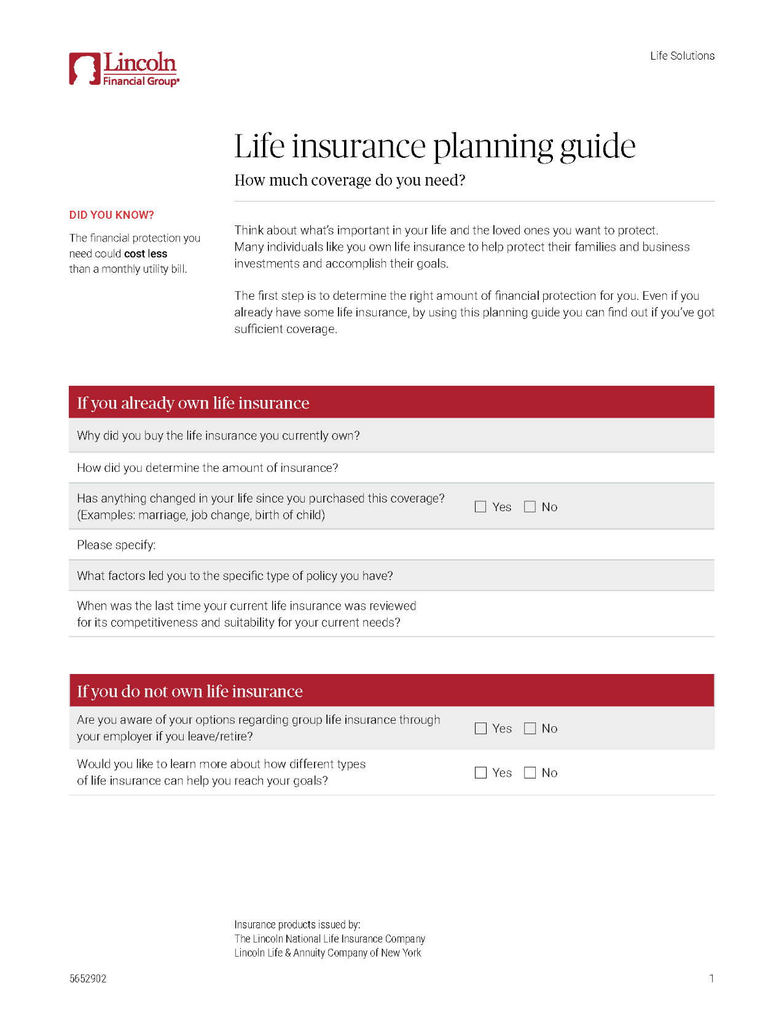


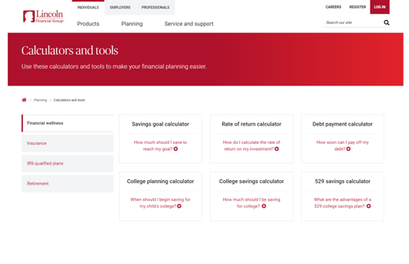
Add some life to the conversation
Show clients how life insurance is the best solution for their needs using our life insurance planning guide and life insurance calculator.
2 IN 5
need life insurance or need more insurance coverage¹
Life Insurance Planning Guide
Life Insurance Calculators
¹LIMRA, “The Facts of Life and Annuities, 2023 Update.”
Notes:
Now that you know the steps of a successful policy review, let’s talk about ways to add some life to your client conversations. Start by asking your clients this: did you know that in a recent study, about 2 in 5 U.S. households said they didn’t have enough life insurance? <Click> [Read slide]

Slide 12
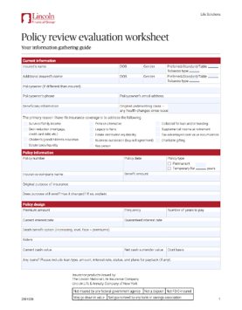


Add some life to the conversation
Policy review
worksheet
Life insurance retirement
planning guide
Life insurance strategy guide for business owners
Notes:
Tailor a solution to fit your clients’ unique needs using <Click> our policy review worksheet. Share sophisticated solutions with your clients using our <Click>; life insurance retirement planning guide <Click>; and life insurance strategy guide for business owners

Slide 13
Your policy review checklist
Prospect and set up meetings
Gather financial data
Determine needs
Request illustrations
Review the “policy people”
Evaluate policy performance
Contact your Lincoln representative
Present findings and recommendations
Notes:
Ready to start building your business with policy reviews? <Click> [Read] <Click> [Read] <Click> [Read] <Click> [Read] <Click> [Read] <Click> [Read]
<Click> [Read] <Click> [Read]

Slide 14
Your policy review checklist
Prospect and set up meetings
Gather financial data
Using the Life Insurance Planning Guide
Have your client provide their existing policy
Determine needs
Request illustrations
Review the “policy people”
Evaluate policy performance
Contact your Lincoln representative
Life Insurance Planning Guide
Present findings and recommendations
Notes:
Ready to start building your business with policy reviews? <Click> [Read] <Click> [Read] <Click> [Read] <Click> [Read] <Click> [Read] <Click> [Read]
<Click> [Read] <Click> [Read]

Slide 15
Your policy review checklist
Prospect and set up meetings
Gather financial data
Determine needs
  Using the Client Policy Worksheet
Request illustrations
Review the “policy people”
Evaluate policy performance
Policy review worksheet
Contact your Lincoln representative
Present findings and recommendations
Notes:
Ready to start building your business with policy reviews? <Click> [Read] <Click> [Read] <Click> [Read] <Click> [Read] <Click> [Read] <Click> [Read]
<Click> [Read] <Click> [Read]

Slide 16
Your policy review checklist
Prospect and set up meetings
Gather financial data
Determine needs
Request illustrations
A variety of different projections can be created to best meet a client’s objectives
Send the request to: CustServSupportTeam@lfg.com
Review the “policy people”
Evaluate policy performance
Contact your Lincoln representative
Present findings and recommendations
Notes:
Ready to start building your business with policy reviews? <Click> [Read] <Click> [Read] <Click> [Read] <Click> [Read] <Click> [Read] <Click> [Read]
<Click> [Read] <Click> [Read]

Slide 17
Your policy review checklist
Prospect and set up meetings
Gather financial data
Determine needs
Request illustrations
Review the “policy people”
Learn their motivation for taking out the policy and who was important to them at the time
  Refer to the “Ten most common life insurance mistakes and how to avoid them”
Evaluate policy performance
Contact your Lincoln representative
Present findings and recommendations
Notes:
Ready to start building your business with policy reviews? <Click> [Read] <Click> [Read] <Click> [Read] <Click> [Read] <Click> [Read] <Click> [Read]
<Click> [Read] <Click> [Read]

Slide 18
Your policy review checklist
Prospect and set up meetings
Gather financial data
Determine needs
Request illustrations
Review the “policy people”
Evaluate policy performance
Does the policy meet the current needs of the client, or are their better solutions available now?
Contact your Lincoln representative
Present findings and recommendations
Notes:
Ready to start building your business with policy reviews? <Click> [Read] <Click> [Read] <Click> [Read] <Click> [Read] <Click> [Read] <Click> [Read]
<Click> [Read] <Click> [Read]

Slide 19
Your policy review checklist
Prospect and set up meetings
Gather financial data
Determine needs
Request illustrations
Review the “policy people”
Evaluate policy performance
Contact your Lincoln representative
  Or reach out to Lincoln Advanced Sales at advancedsales@LFG.com or 800-832-5372
  or the Competitive Services Group at
  competition@LFG.com or 866-888-9822
Present findings and recommendations
Notes:
Ready to start building your business with policy reviews? <Click> [Read] <Click> [Read] <Click> [Read] <Click> [Read] <Click> [Read] <Click> [Read]
<Click> [Read] <Click> [Read]

Slide 20
Your policy review checklist
Prospect and set up meetings
Gather financial data
Determine needs
Request illustrations
Review the “policy people”
Evaluate policy performance
Contact your Lincoln representative
Present findings and recommendations
Your review is so important to your clients!
Notes:
Ready to start building your business with policy reviews? <Click> [Read] <Click> [Read] <Click> [Read] <Click> [Read] <Click> [Read] <Click> [Read]
<Click> [Read] <Click> [Read]

Slide 21

People, Products, Process – that’s what Lincoln is all about.
Reach out to your Lincoln representative today for more tips on making Policy Reviews part of your best practices.
Notes:
Partnering with us helps you deliver sophisticated strategies to fit every client’s needs. Our commitment to clients is to help them plan for retirement, prepare for the unexpected and protect their wealth. We’re also committed to supporting you from start to finish as you build your business. Rely on our expertise and knowledge to help you protect your client’s wealth and plan successful financial outcomes.

Slide 22
Thank You
Notes:
I hope that I’ve provided insight into the importance of policy reviews. Please reach out with any questions or for more ways you can provide the best service to your clients.

Slide 23
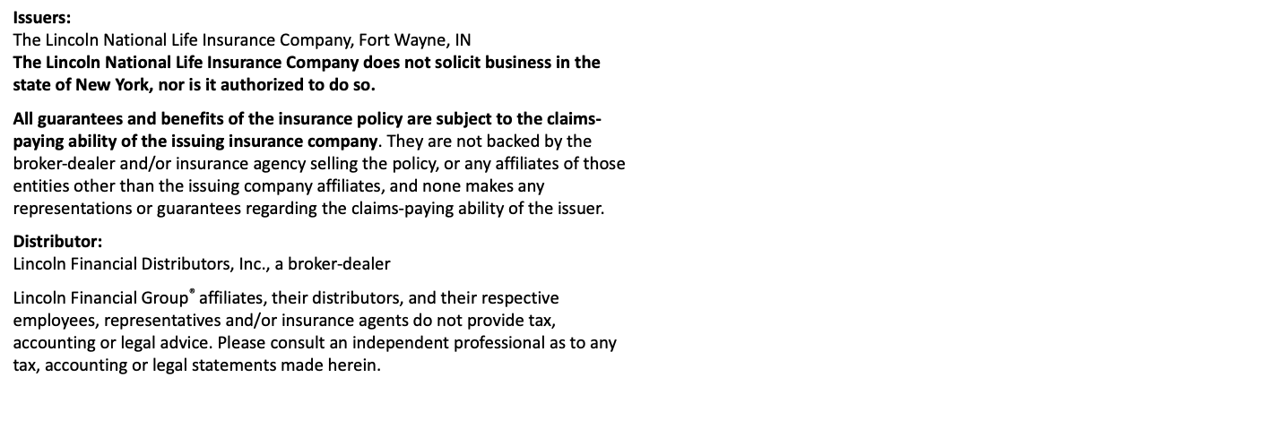
Disclosures

